Slide 1
Modeling ΦX-174 Gene Expression and Attenuation
Tanvi Ingle
Wilke Lab Presentation 12.3.2021

Slide 2

Viral gene expression is important!

Slide 3
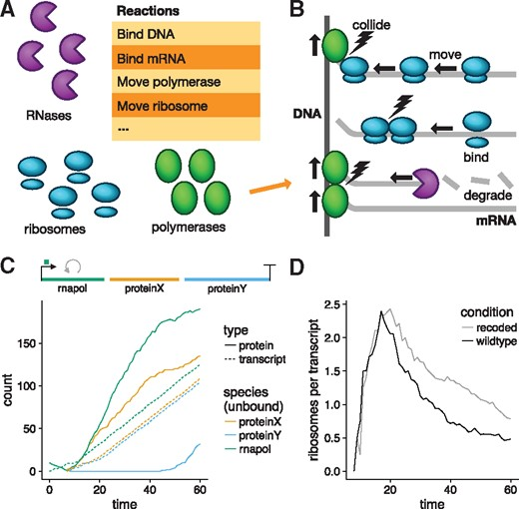
Pinetree simulates viral transcription & translation

Slide 4
Pinetree simulates viral transcription & translation

Slide 5
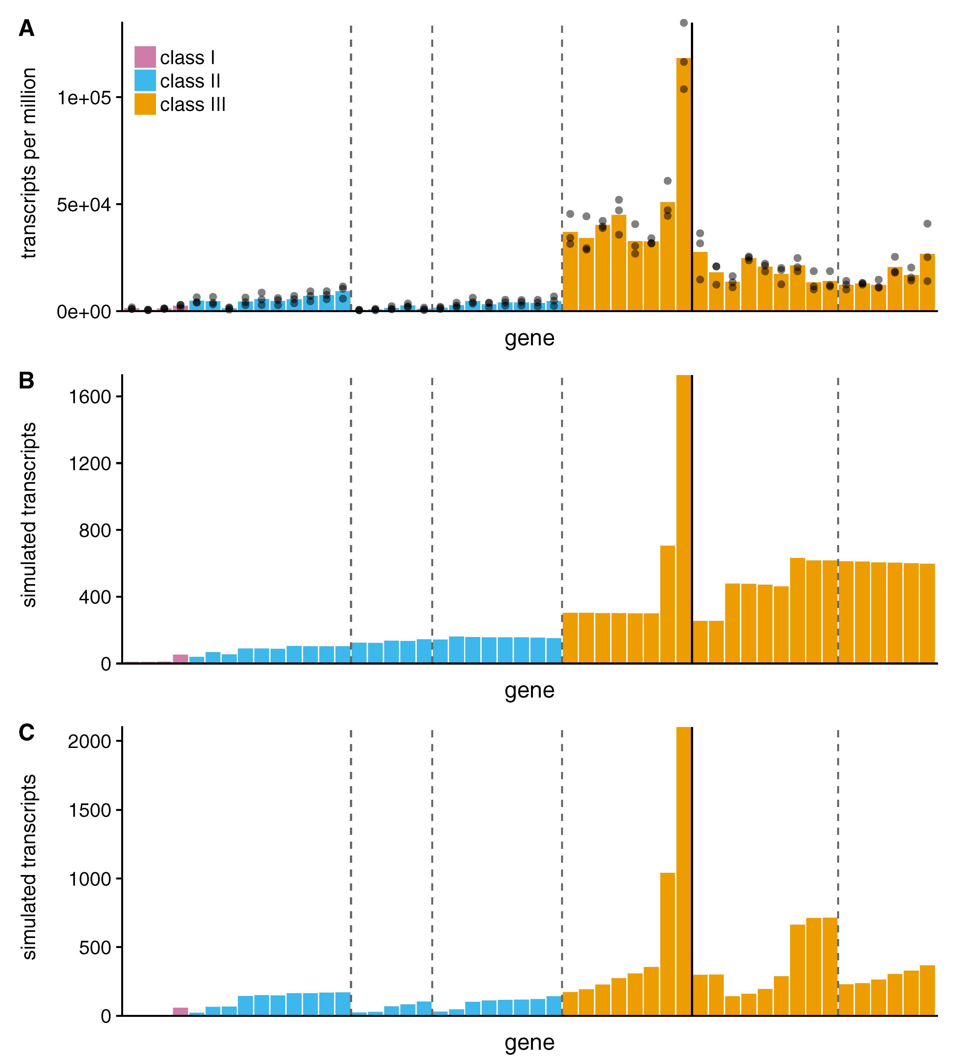
Previous work with Pinetree used T7
Notes:
T7 m modeled → show works well. What about other viruses?
Lots of param with ambiguous or understudied values in literature → how to leverage pinetree to model these viruses?

Slide 6
Can we use Pinetree to study other viruses?
Can Pinetree recapitulate ΦX-174 gene expression patterns?
Can Pinetree model ΦX-174 attenuation?

Slide 7
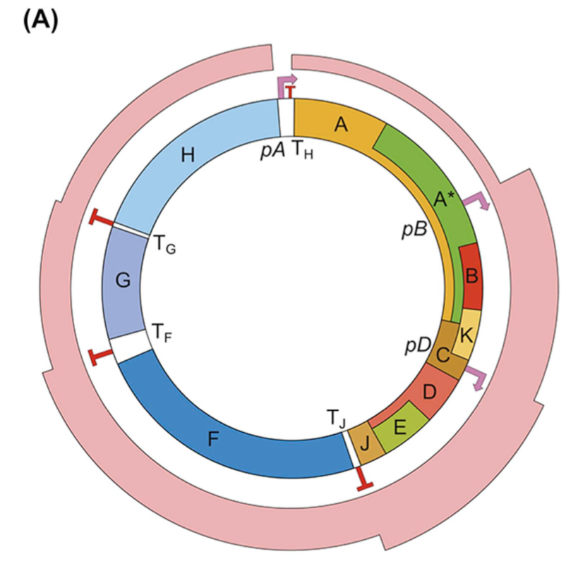
Why study ΦX-174?
ΦX-174 genome (Figure 1A, Logel 2020)
Notes:
“My lab is working to construct modified T7 phages and experimentally test predictions of PineTree and related simulations—in terms of gene expression, fitness, and evolvability. We've discussed with Claus adding a phage like phiX-174 that has a smaller genome to that work, so I look forward to seeing how your work goes.”

Slide 8
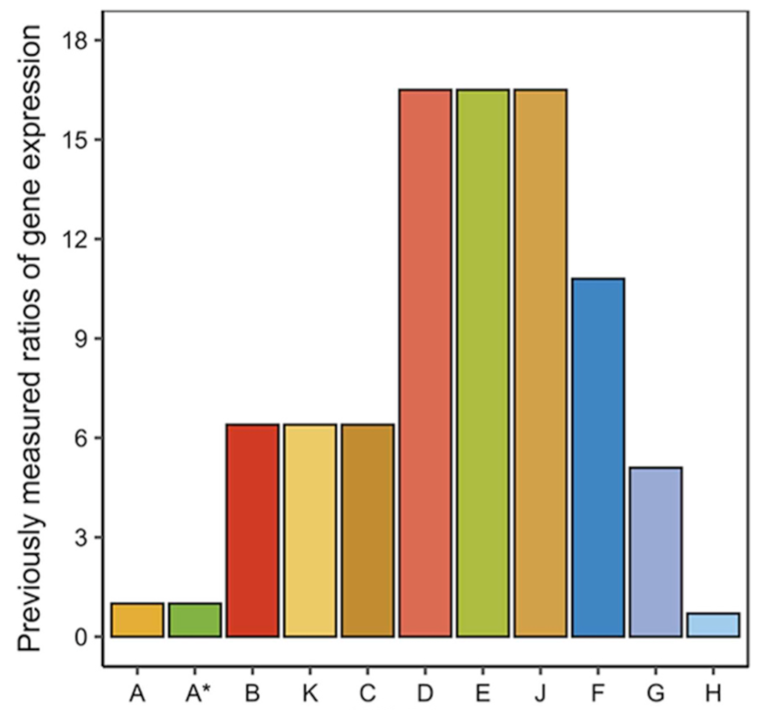
Can Pinetree recapitulate ΦX-174 expression?
qPCR data (Figure 1B, Logel 2020)

Slide 9
Pinetree can recapitulate ΦX-174 expression
qPCR data (Figure 1B, Logel 2020)
Simulated pinetree output!

Slide 10
Systematic Approach: optimization method
Define a unique normal distribution (~N(u,o)) for each of the three promoters (pA, pB, pD). Let the promoter strength be e^u_value and step size be the st. deviation o.

Slide 11
Systematic Approach: optimization method
Define a unique normal distribution (~N(u,o)) for each of the three promoters (pA, pB, pD). Let the promoter strength be e^u_value and step size be the st. deviation o.
Define a normal distribution to describe lambda. Here, lambda represents the value by which the step size will be scaled.

Slide 12
Systematic Approach: optimization method
Define a unique normal distribution (~N(u,o)) for each of the three promoters (pA, pB, pD). Let the promoter strength be e^u_value and step size be the st. deviation o.
Define a normal distribution to describe lambda. Here, lambda represents the value by which the step size will be scaled.
Randomly select a promoter to optimize (pA, pB, pD). Feed promoter values into pinetree & calculate RMSE.
If the new error (NE) is less than the old error (OE), then keep the promoter value.
If not, increment the promoter value by the scaled step size (add e^lambda*o). Keep repeating with randomly selected o value until NE < OE. Stop after 4 iterations & move onto the next promoter value.

Slide 13
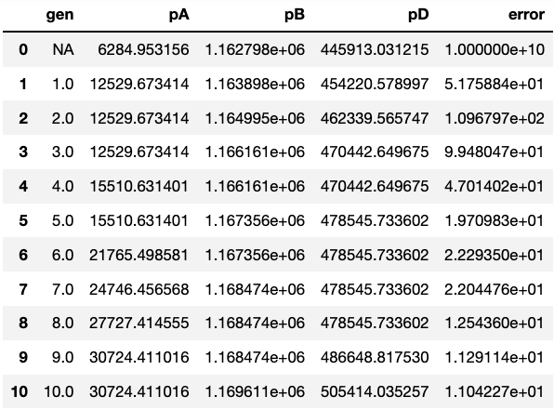
Preliminary results show optimization technique works ok

Slide 14
Next Steps: finishing the optimization
Run w/ different assumed promoter strength distributions & have multiple trials (10ish) within each distribution
Extract best runs and rerun them with different seeds
Repeat this process but fit to RNA-seq data

Slide 15
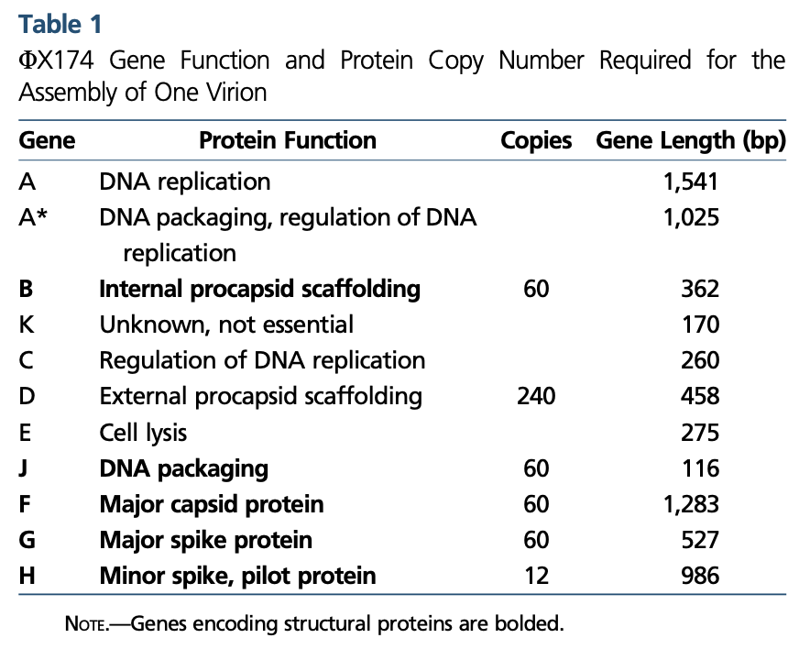
Next Steps: Can Pinetree recapitulate viral attenuation?
Evidence that modularized genomes attenuate viral fitness
Recapitulate patterns in Wright 2020
Table 1, Leuven 2021

Slide 16
Life Update
AKA why I’ve been pretty MIA this semester

Slide 17
Applying to MD and MD/PhD programs!
Places I have an interview with
UT Medical Branch (MD/PhD & MD)
UT San Antonio (MSTP & MD)
Texas A&M (MD/PhD & MD)
Dell Medical School (MD)
UT Southwestern (MD)
UTHealth McGovern Medical School (MD)
Places I am waiting to hear back from
Dartmouth (MD/PhD)
UCSF (MSTP)
Baylor (MSTP)
University of Houston College of Medicine (MD)
Texas Tech University Health Sciences Center (MD)
Notes:
Pittsburg
Emory
Brown
UW
UT El Paso & Rio Grande Valley

Slide 18
Applying to MD and MD/PhD programs!
Places I have an interview with
UT Medical Branch (MD/PhD & MD) → MD Prematch! Waiting to hear from MD/PhD
UT San Antonio (MSTP & MD)
Texas A&M (MD/PhD & MD)
Dell Medical School (MD)
UT Southwestern (MD)
UTHealth McGovern Medical School (MD)
Places I am waiting to hear back from
Dartmouth (MD/PhD)
UCSF (MSTP)
Baylor (MSTP)
University of Houston College of Medicine (MD)
Texas Tech University Health Sciences Center (MD)
Notes:
Pittsburg
Emory
Brown
UW
UT El Paso & Rio Grande Valley

Slide 19
THANK YOU!!!
Most sincerely

